Slide 1
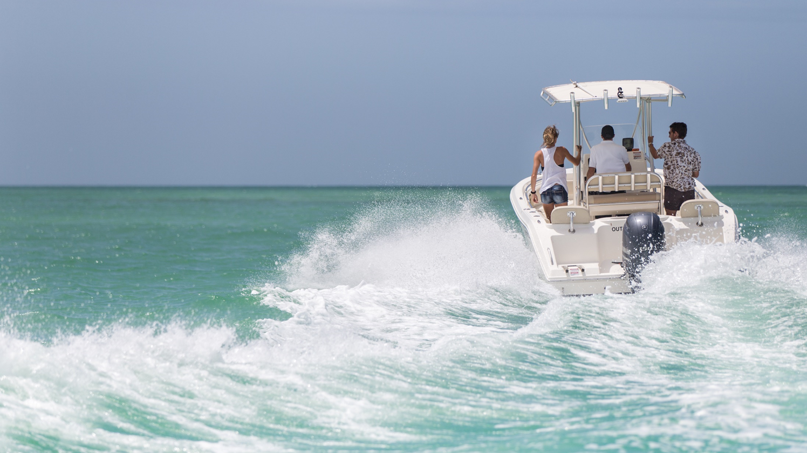
Trade Update
Impact on the Marine Industry
Notes:
N

Slide 2
Webinar Presenters
T. Nicole Vasilaros, Esq.
Senior Vice President, Government and Legal Affairs
Sara Anghel
President
NMMA Canada

Slide 3
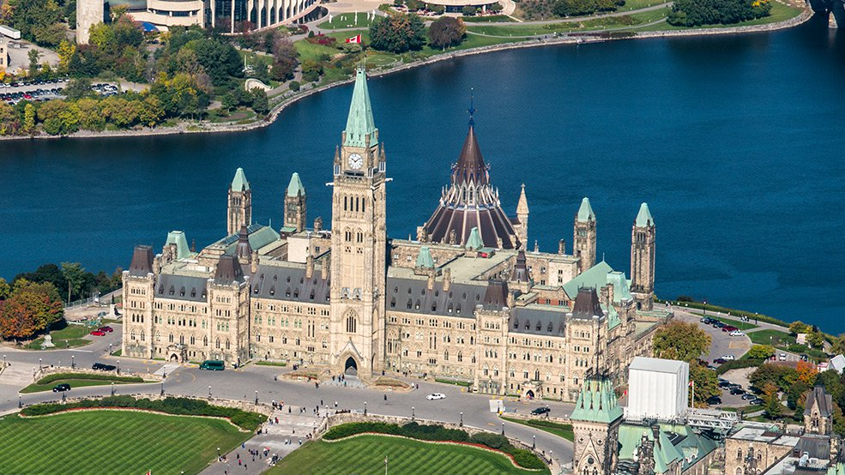
On Today’s webinar
Tariff Overview and Marine Industry Impact
Section 232
Background
Current Status
Foreign Retaliation
Impact on the Marine Industry
3. Take Action
NMMA engagement timeline
NMMA Letter to Prime Minister Trudeau
Join the Fight Against Tariffs
4. Q&A

Slide 4
Tariff Overview
Marine Industry Impact

Slide 5
NAFTA
Section 301
China
Section 232
Steel and Aluminum
Marine Industry
Antidumping and Countervailing Duties (AD/CVD) Chinese Aluminum Sheet
Retaliation

Slide 6
Tariffs Impact All of the marine Industry
Raw Materials
Components
Exports
Aluminum is a critical raw material for boat manufacturing.
In 2017, 117,000 or 44% of boats sold were primarily aluminum based.
Section 232 and AD/CVD tariffs are increasing global prices on aluminum, resulting in higher prices for marine manufacturers.
Component parts and accessories add value and safety to boats, ultimately enhancing the user experience.
Section 301 tariffs impact nearly 300 marine related products ranging from engines to propellers to marine navigation and component parts.
Exporting opens huge untapped markets for U.S. marine businesses, with more than 95% of the world’s consumers outside the U.S.
In 2017, exports increased 9.6% totaling $1.7 billion in value
Retaliation from trading partners targets ALL BOATS, not just aluminum, destined for their markets with tariffs.

Slide 7
Tariffs = Tax
Tariffs are a tax on goods imported from overseas, making them less attractive to consumers.
History illustrates that the marine industry does not fare well with burdensome excise taxes on boats.
In the 1990’s a 10% tax on boats nearly sunk the industry, resulting in numerous boat manufacturers going out of business and nearly 25,000 American workers losing their jobs.
Finland, Turkey, Italy have all attempted to levy
Demand for marine products is highly elastic and sensitive to even small changes in the sales price of boats.
Increased tariffs for raw materials will increase the overall product cost and place additional burdens on the end user’s purchasing power.

Slide 8
Section 232

Slide 9
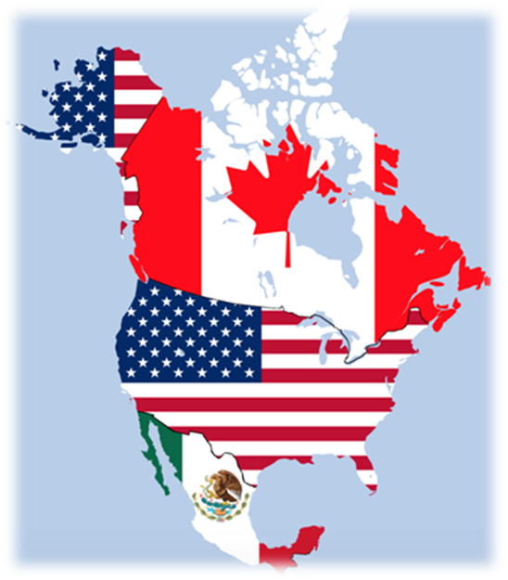
Section 232 Tariffs: Background
Section 232 of the Trade Expansion Act of 1962 allows the federal government to block or restrict imports to protect U.S. national security interests, including economic security.

Slide 10
Section 232 Tariffs: Current Status
March 2018 President Trump exercised his authority to impose a 10% tariff on aluminum and 25% on steel– worldwide.
June - July, 2018
Canada, Mexico, and European Union enact tariffs against all ALL boats
June 1, 2018
President Trump imposes steel and aluminum tariffs on Mexico, Canada and the European Union (EU) after previously exempting the countries.
March – May 2018
Some countries negotiated a compromise with the U.S. in the form of quotas and are now exempt. They include: Brazil, South Korea, Australia
June 2018
EU, Canada, and Mexico respond with proposed retaliatory tariffs on range of US products including ALL boats.

Slide 11
Retaliation

Slide 12
Canada
Status
Impacted HTS Codes
Effective July 1, 2018: Canada imposes 10% tariff against U.S. imports of boats.
Canada represents $562 million (USD) or 37% of U.S. boat exports
In 2017, more than 100,000 new and pre-owned boats were sold in Canada. Of those more than 65% came from the U.S.
The U.S. is the top market for both imports and exports in Canada with engines and boats imported from the U.S. totaling $797.2 million and exports into the U.S. totaling $192.8 million (Cdn $)
Comments from stakeholders due to International Trade Policy Division at the Department of Finance on June 15, 2018
8903.10 - Inflatable Boats
8903.91 - Sailboats, with or without auxiliary motor
8903.92 - Motorboats, other than outboard motorboats
8903.99.90 - Outboard motorboats, other vessels for pleasure or sports, nes

Slide 13
Canada
Outlined below are the industry’s specific requests of the Government of Canada:
Remove 8901.10, 8903.91, 8903.92, 8903.99.90 from the proposed scope of countermeasures to align with other recreational products;
Countless boats will have already been purchased or ordered but will cross the border after the July 1 deadline. Should these tariffs be imposed, the Canadian dealer will be responsible for the tariff and unable to pass through the cost. We ask that should the four tariffs remain, a grace period of six months be implemented to allow Canadian dealers to adapt to the new pricing scheme; and,
Should the tariffs proceed, and subsequently be removed in a few months, we request the tariff be paid back so as to not unfairly burden the Canadian importer/dealer who will not have been able to pass the cost through.

Slide 14
European Union
Impacted HTS Codes
89039110 - Sea-going sailboats and yachts, with or without auxiliary motor, for pleasure or sports
89039190 - Sailboats and yachts, with or without auxiliary motor, for pleasure or sports (excl. seagoing vessels)
89039210 - Sea-going motor boats and motor yachts, for pleasure or sports (other than outboard motor boats)
89039291 - Motor boats for pleasure or sports, of a length <= 7,5 m (other than outboard motor boats)
89039299 - Motor boats for pleasure or sports, of a length > 7,5 m (other than outboard motor boats and excl. seagoing motor boats)
89039910 - Vessels for pleasure or sports, rowing boats and canoes, of a weight <= 100 kg each (excl. motor boats powered other than by outboard motors, sailboats with or without auxiliary motor and inflatable boats)
89039991 - Vessels for pleasure or sports, rowing boats and canoes, of a weight > 100 kg, of a length <= 7,5 m (excl. motor boats powered other than by outboard motors, sailboats with or without auxiliary motor and inflatable boats)
89039999 - Vessels for pleasure or sports , rowing boats and canoes, of a weight > 100 kg, of a length > 7,5 m (excl. motor boats and motor yachts powered other than by outboard motors, sailboats and yachts with or without auxiliary motor and inflatable boats)
Status
Effective as early as June 20, 2018: EU imposes 25% tariff against U.S. imports of boats
European Union represents $338.5 or 22% of U.S. boat exports
EU Countries will vote on Thursday June 11, 2018 to endorse the European Commissions proposal for retaliatory tariffs
Following this formal step, the Commission will be allowed to move forward with implementation of the tariff across the EU

Slide 15
Mexico
Status
Impacted HTS Codes
Effective Immediately: Mexico imposes 15% tariff against U.S. imports of boats
Mexico represents $147.4 million or 10% of U.S. boat exports
8903.92.01 - Motor boats, except for outboard motor.

Slide 16
Retaliation: Frequently Asked Questions
Who pays the tariff?
New or used boats?
Are engines included?
Boats purchased prior to July 1st?
Why are boats being targeted?
When do the tariffs end?

Slide 17
How you can help

Slide 18
NMMA Response
November 2017: NMMA testifies at ITC on aluminum sheet AD/CVD
March 2018: NMMA works with Members of Congress to question Ambassador Lighthizer on marine tariff impact
March 15, 2018: NMMA, ICOMIA, and EBI issue joint statement opposing 232 measures and retaliation
May 2018: 180 meetings held during American Boating Congress
May 16, 2018: NMMA testifies at hearing opposing 300 marine related tariffs as part of section 301 investigation
On June 7, 2018, NMMA President Thom Dammrich sent a letter to President Trump regrading the compounding effect of tariffs on the boating industry.
June 7, 2018: NMMA supports Senator Corker legislation to roll back tariff actions
June 11, 2018: 5 Members of Congress send letter to Department of Commerce and ITC on marine industry impact

Slide 19
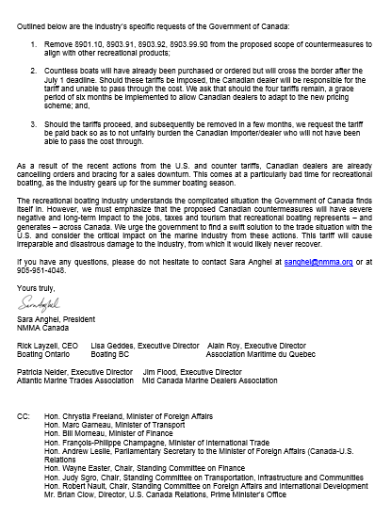
NMMA Letter to Prime Minister TrUdeau
Today, NMMA Canada President, Sara Anghel and all regional marine trades associations co-signed a letter to the Prime Minister and dozens of Members of Parliament outlining our concern with the proposed retaliatory tariffs. Our efforts will also extend into some provincial governments who have reached out to ask us what the impact will be.
Grassroots efforts are already underway as dealers and manufacturers have sent letters to the Members of Parliament.
Meeting request has gone out to discuss the issue with the Minister of Trade.
We stated “The recreational boating industry understands the complicated situation the Government of Canada finds itself in. However, we must emphasize that the proposed Canadian countermeasures will have severe negative and long-term impact to the jobs, taxes and tourism that recreational boating represents – and generates – across Canada. We urge the government to find a swift solution to the trade situation with the U.S. and consider the critical impact on the marine industry from these actions. This tariff will cause irreparable and disastrous damage to the industry, from which it would likely never recover.”

Slide 20
Join the fight!
Sign the Boating United Petition to President Trump, his Administration, and Congress and tell them to make a deal that immediately withdraws these tariffs.
https://www.votervoice.net/NMMA/Petitions/1356/Respond
Share the impact of tariffs on your business with NMMA
Notes:
N

Slide 21
Submit Comments to Canadian Government
The Right Hon. Justin Trudeau, P.C., M.P.
Prime Minister of Canada
80 Wellington Street
Ottawa, Ontario K1A 0A3
Canada
Justin.Trudeau@parl.gc.ca
Formal submissions due to the Finance Tariff Consultation by June 15, 2018
fin.tariff-tarif.fin@canada.ca
Write your local Member of Parliament Firstname.lastname@parl.gc.ca

Slide 22
Questions?
Nicole Vasilaros
nvasilaros@nmma.org
202-737-9763
Sara Anghel
sanghel@nmma.org
905-951-4048
For more information, visit www.nmma.org

