Slide 1
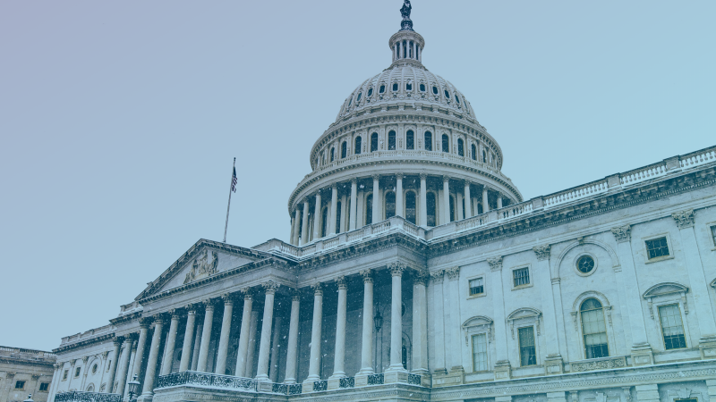
How the $2 Trillion Stimulus Package Helps Boating Industry Businesses
Notes:
N

Slide 2
Nicole Vasilaros
Senior Vice President, Legal & Government Affairs
NMMA
George Cooper
Partner
Forbes Tate Partners
Notes:
N

Slide 3
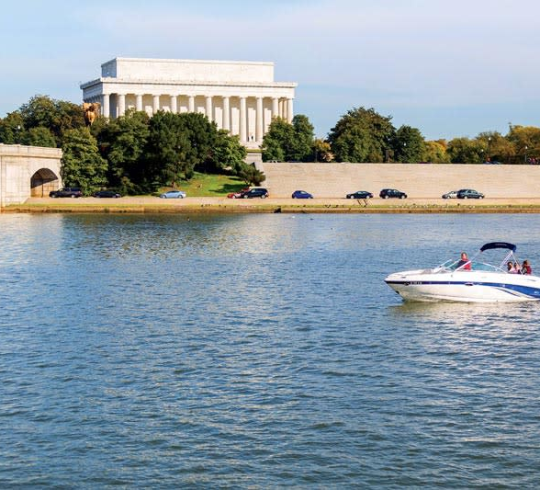
On today’s webinar:
Federal response
NMMA stimulus priorities
CARES Act overview
What’s on the horizon
Next steps at the state level
Resources
Notes:
N

Slide 4
Federal COVID-19 Response to Date
March 6
$8.3 billion emergency coronavirus spending package
March 18
$100 billion Families First Coronavirus Response Act
March 27
$2.2 trillion CARES Act
Notes:
G

Slide 5
Phase One
$8 billion funding for public health agencies including:
$4 billion to make tests available
$1 billion in loan subsidies for small businesses
Notes:
G
Paid Family and Sick Leave:
All employees of covered employers are eligible for two weeks of paid sick time for specified reasons related to COVID-19. Employees employed for at least 30 days are eligible for up to an additional 10 weeks of paid family leave to care for a child under certain circumstances related to COVID-19.
To help employers afford the new paid sick leave and paid FMLA benefits, businesses are able to seek reimbursement through tax credits applied against employer’s already-owed Social Security taxes. If that doesn’t fully offset costs, Treasury is authorized to help cover the rest with cash payouts and waive penalties for businesses for not submitting payroll taxes if they do so in anticipation of a refund under this law.
Treasury will soon be releasing a form for small businesses to request an expedited advance on their refund.
Unemployment Insurance
Allocates $1 billion in funds for state unemployment programs and gives states flexibility in providing UI to workers.
Eliminates need or employees to wait a week before becoming eligible for UI and eases work search requirements

Slide 6
Phase Two Families First Coronavirus Response Act
Free testing
Two weeks paid sick and family leave
Increased unemployment insurance benefits
Notes:
G

Slide 7
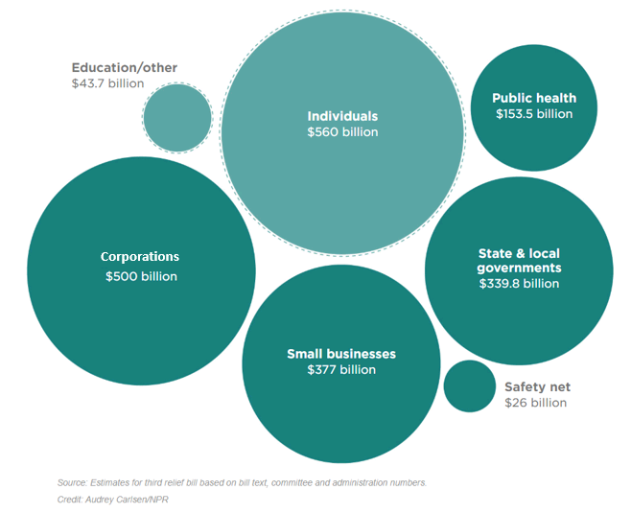
Phase Three
Coronavirus Aid, Relief, and Economic Security Act (CARES Act)
Notes:
G

Slide 8
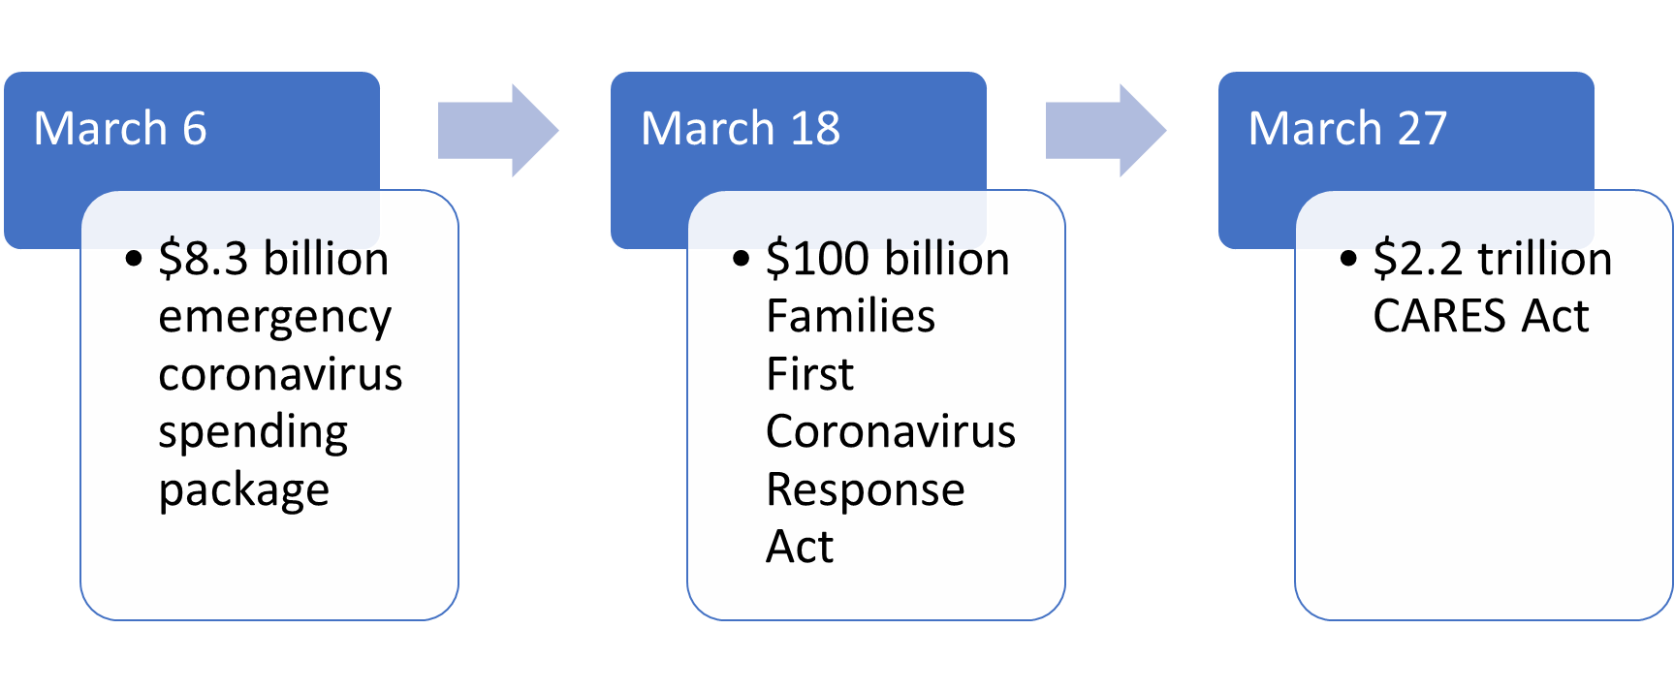
Historic Levels of Relief
2008
TARP $700 billion bailout
2009
ARRA $831 billion stimulus
2010
Dodd-Frank
The 2008 financial crisis relief equated to 10 percent GDP over the course of three years.
In just one month, the coronavirus relief package equates to 10 percent GDP – a total $3 trillion
Notes:
G

Slide 9
NMMA Stimulus Priorities
Ensure Financial Certainty for Businesses
Short-term lending
Supply chain
Business operations
Liquidity
Employee protection
Tariff Relief
Continued Access to Public Waters
Notes:
N

Slide 10
Navigating the CARES Act

Slide 11
CARES Act Wins for the Boating Industry
$350 billion in small business loans
SBA small business standard for boat builders <1,000
Delayed payment of social security payroll taxes
Modifications for net operating losses to provide more cash flow
Temporary, full funding for state short-term compensation programs
U.S. Treasury new lending program targeted at medium-sized businesses (500-10,000 employees)
Grant program to educate and advise businesses to utilize new programs to assist with recovery
Notes:
N

Slide 12
Direct Aid to Workers and Families
Rebate Check
Provides $1,200/taxpayer ($2,400 joint filers)
Unemployment Insurance
Provides $600/week up to four months (+state benefits)
Gives additional 13 weeks of federal unemployment benefits
Student Loan Deferment
Delays student loan payment, principal, and interest for six months
Gives an Extra $500 per child
Phases out > $75k single/$198k joint filers
Notes:
N

Slide 13
Support for Small Businesses

Slide 14
Are you a business with less than 500 employees or a boat manufacturer with less than 1,000?
YES
NO
Emergency Economic Injury Disaster Loan
Paycheck Protection Program
Existing SBA loan relief
Short-Term Compensation
Payroll Tax Credit
Social Security Tax Deferment
Net Operating Loss carry back
Immediate write off of facility improvement costs
Immediate recovery of AMT credits
50% write-off of business interest expenses
Payroll Tax Credit
Social Security Tax Deferment
Net Operating Loss carry back
Immediate write off of facility improvement costs
Immediate recovery of AMT credits
50% write-off of business interest expenses
Federal Reserve 13(3) program
Notes:
N

Slide 15
Paycheck Protection Program
Eligibility
Fewer than 500 employees
Meets SBA’s industry size standard (1,000 employees for boat building)
Amount
2.5x the business’s average monthly payroll costs
Up to $10 million
Loan Forgiveness
8 weeks for payroll costs (salary/wages/healthcare/rent/utilities) Reduced if there is a reduction in employees or wages greater than 25%
Lenders
Distributed through 2,500+ lenders and SBA
Program is open until June 30, 2020
Notes:
N

Slide 16
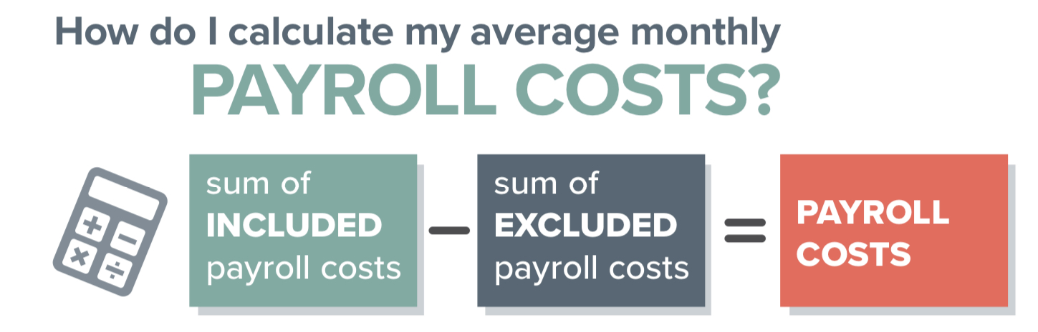

Slide 17
Paycheck Protection Program FAQ
What if my company is owned by a larger parent company or we have multiple business locations?
The number of employees across all brands or locations must be aggregated. So long as there is common governance, ownership or direction the brands/locations are treated as one.
If my facility shuts down due to a state order, would paid wages under this program be forgiven even if they are not currently working?
Yes
What if I already instituted a workforce reduction?
You can bring back employees retroactively through February 15th
Can an owner’s salary be covered if it is under $100k?
Yes, any salary under $100,000 can be applied to this program
Can I use a different bank than the one I use for my current SBA 7(a) loan?
Yes. This program can be accessed by more than 2,500 financial institutions (e.g., banks, credit unions)
If I use this loan to cover payroll, can I still receive the tax credit for payroll costs?
No
Will this loan be considered taxable income?
No
What if I receive the loan but have to layoff employees?
A wage reduction above 25% or employee reduction will not be forgiven and subject to interest up to 1%.
Notes:
N

Slide 18
SBA Disaster Assistance
Economic Injury Disaster Loan (EIDL)
Small businesses with < 500 employees
Up to $2 million
An advance of $10,000 to small businesses within three days
Existing SBA Loan Relief
$17 billion
SBA will cover all loan payments for existing borrowers for up to six months. six months
Currently available via: https://www.sba.gov/disaster-assistance/coronavirus-covid-19
Notes:
N
Existing Loan Relief
SBA is required to pay the principal, interest, and associated fees owed on certain existing SBA loans and loans made in the next six months
Refinancing
It allows a borrower who has an EIDL loan related to COVID-19 to apply for a PPP loan, with an option to refinance that loan into the PPP loan. However, the EIDL advance of up to $10,000 would be subtracted from the amount forgiven under the PPP. Existing EIDL borrowers not related to COVID-19 are also eligible to apply for PPP for payroll assistance but they cannot refinance into a PPP.

Slide 19
Short-Term Compensation (STC)
What is STC?
Unemployment compensation system that provides partial unemployment benefits to workers whose hours have been reduced in lieu of a layoff
How can an STC agreement help businesses?
Reduces payroll expenditures
Helps businesses to avoid layoffs and retain skilled workforce through economic downturns
How do I apply?
Employers must have an approved STC plan in place with appropriate state workforce agency (Currently available in 23 states)
STC application process is initiated by employers- not employees
What did CARES Act provide?
Temporary full funding of existing state programs
Funding and Department of Labor technical assistance for states without STCs to enact and implement programs
Notes:
N

Slide 20
Economic Stabilization for Industry

Slide 21
Small & Medium-Sized Business Assistance
$454 billion available for direct lending via Federal Reserve’s 13(3) program
Businesses with between 500-10,000 employees
Must maintain 90% of employees
Prohibits offshoring of jobs and abrogation of existing collective bargaining agreements
Notes:
N

Slide 22
Additional Business Relief
Modification of Net Operating Loss
Payroll Tax Credit
Social Security Tax Deferment
50% write-for for business interest expenses
Immediate recovery of AMT credits
Immediate write-off of facility improvement costs
Notes:
N

Slide 23
Payroll Tax Relief
Tax Credit
Refundable payroll tax credit for 50 percent of wages paid by employers whose operations were suspended due to COVID-19 or who had gross receipts that were 50 percent lower than the same quarter in the previous year.
Payroll Tax Deferment
Defer employer share of 6.2 percent Social Security tax. First half due by December 31, 2021 and the remaining half by December 31, 2022.
Notes:
N

Slide 24
Modifies Net Operating Loss (NOL)
Allows NOLS from 2018-2020 to be carried back five years
Removes the taxable income limitation to allow an NOL to fully offset income
Notes:
N

Slide 25
What is on the Horizon?
Tariff Relief
Defense Production Act
Main Street Lending Program
Fourth Stimulus Package
Fifth Stimulus Package?
Additional state aid and assistance
Notes:
G

Slide 26
Tariff Relief
Removed some Section 301 tariffs related to fishing tackle bags, certain trailers, cleats and chocks, and components such as cam/crankshafts and certain mountings/fittings.
Growing bipartisan support on Capitol Hill to suspend all tariffs for at least 90 days.
Notes:
G

Slide 27
Defense Production Act (DPA)
Allows the president to incentivize companies to increase production of any good/material that is essential to national security.
President has invoked the DPA to compensate for a lack of personal protective equipment for medical community
On March 27, president invoked the DPA on General Motors to produce ventilators
Notes:
G

Slide 28
Stimulus 4 Package
Infrastructure
Surface transportation
Water Resources Development Act
Sport Fish Restoration and Boating Trust Fund
Fixes to previous relief packages
Affiliation definitions
Extension of payroll loans?
Notes:
G

Slide 29
State Actions
Stay at Home Orders
Essential Business Designations
Access Restrictions
State Assistance
Visit: nmma.org/coronavirus
Notes:
N

Slide 30
State Fiscal Response to Date
Notes:
N
Legislatures are moving quickly to ensure agencies and local governments have the funds to prepare and respond to the coronavirus outbreak.
Several states (highlighted in graphic) have enacted legislation that either appropriates additional funding for coronavirus related tasks or authorizes a transfer of funds from the states rainy day fund.
Following passage of the first three phases of federal stimulus, focus largely shifts to states as they assess budgets and determine where needs are to support residents and businesses at the state level

Slide 31
Resources
NMMA’s COVID-19 Web Page: https://www.nmma.org/coronavirus
Guide to Paycheck Protection Program (PPP)
https://www.uschamber.com/sites/default/files/023595_comm_corona_virus_smallbiz_loan_final.pdf
How to apply for an SBA loan
https://home.treasury.gov/system/files/136/PPP%20Borrower%20Information%20Fact%20Sheet.pdf
https://home.treasury.gov/system/files/136/Paycheck-Protection-Program-Application-3-30-2020-v3.pdf
CARES Act Funding Flowchart
http://nmma.net/assets/cabinets/Cabinet488/NMMA_Economic%20Relief%20Flow%20Chart.pdf
State Resource Guide
http://nmma.net/assets/cabinets/Cabinet488/NMMA_COVID%20State%20Resources%20One%20Pager_3.31.20.pdf
Notes:
N

Slide 32
Questions?
For additional comments and resources: Taskforce@nmma.org
Notes:
N

