Slide 1
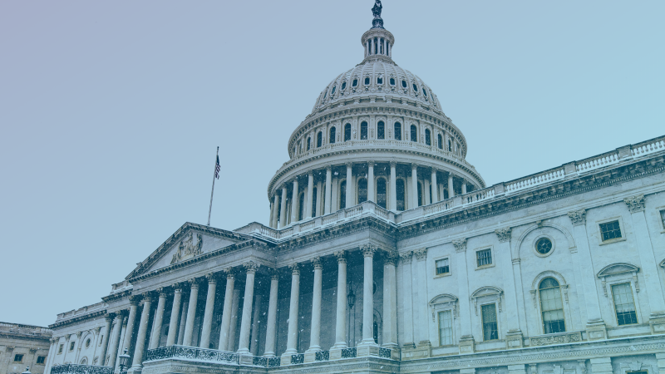
Live Q&A On How To Access COVID-19 Economic Aid
Notes:
N

Slide 2
Ryan Welch
Partner
Forbes-Tate Partners
Trevor Hanger
Strategic Adviser
Forbes-Tate Partners
Nicole Vasilaros
Senior Vice President
NMMA
George Cooper
Partner
Forbes-Tate Partners
Notes:
N

Slide 3
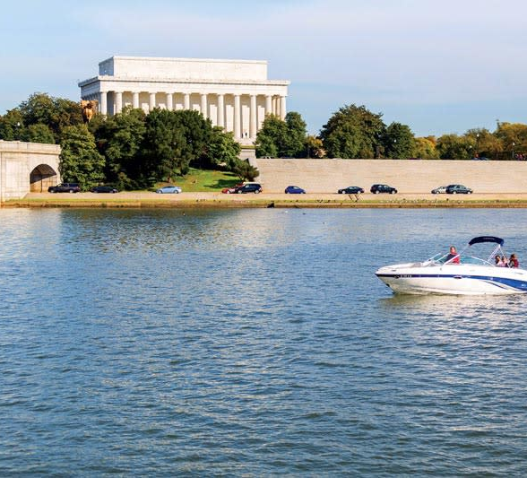
On today’s webinar:
Review of CARES Act
Paycheck Protection Program
Additional Business Relief
What’s on the Horizon?
Q&A Session
Resources
Notes:
N

Slide 4
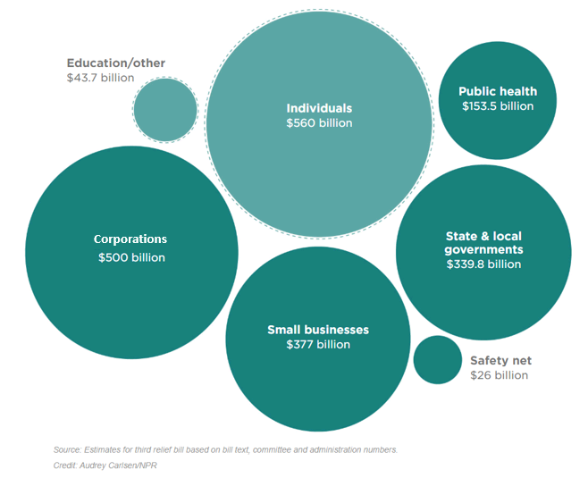
Coronavirus Aid, Relief, and Economic Security (CARES) Act
Notes:
G

Slide 5
CARES Act Wins for the Boating Industry
$350 billion in small business loans
SBA small business standard for boat builders <1,000
Delayed payment of social security payroll taxes
Modifications for net operating losses to provide more cash flow
Temporary, full funding for state short-term compensation programs
U.S. Treasury new lending program targeted at medium-sized businesses (500-10,000 employees)
Grant program to educate and advise businesses to utilize new programs to assist with recovery
Notes:
N

Slide 6
Are you a business with less than 500 employees or a boat manufacturer with less than 1,000?
YES
NO
Emergency Economic Injury Disaster Loan
Paycheck Protection Program
Existing SBA loan relief
Short-Term Compensation
Social Security Tax Deferment
Net Operating Loss carry back
Immediate write off of facility improvement costs
Immediate recovery of AMT credits
50% write-off of business interest expenses
Payroll Tax Credit
Social Security Tax Deferment
Net Operating Loss carry back
Immediate write off of facility improvement costs
Immediate recovery of AMT credits
50% write-off of business interest expenses
Federal Reserve 13(3) program
Notes:
N

Slide 7
Paycheck Protection Program
Eligibility
Fewer than 500 employees
Meets SBA’s industry size standard (1,000 employees for boat building)
Amount
2.5x the business’s average monthly payroll costs
Up to $10 million
Loan Forgiveness
8 weeks for payroll costs (salary/wages/healthcare/rent/utilities) Reduced if there is a reduction in employees or wages greater than 25%
Lenders
Distributed through 2,500+ lenders and SBA
Program is open until June 30, 2020
Notes:
N

Slide 8
Additional Business Relief
Modification of Net Operating Loss
Payroll Tax Credit
Social Security Tax Deferment
50% write-off for business interest expenses
Immediate recovery of AMT credits
Immediate write-off of facility improvement costs
Notes:
N

Slide 9
What is on the Horizon?
CARES 2.0
Tariff Relief
Main Street Lending Program
Fourth Stimulus Package
Fifth Stimulus Package?
Additional State Assistance
Notes:
G

Slide 10
Questions?
For additional comments and resources: Taskforce@nmma.org
Notes:
N

Slide 11
Resources
Guide to Paycheck Protection Program (PPP)
https://www.uschamber.com/sites/default/files/023595_comm_corona_virus_smallbiz_loan_final.pdf
How to apply for the PPP
https://www.nmma.org/assets/cabinets/Cabinet488/NMMA_How_to_apply_PPP.pdf
CARES Act Funding Flowchart
http://nmma.net/assets/cabinets/Cabinet488/NMMA_Economic%20Relief%20Flow%20Chart.pdf
State Resource Guide
http://nmma.net/assets/cabinets/Cabinet488/NMMA_COVID%20State%20R
Frequently Asked Questions
https://www.nmma.org/assets/cabinets/Cabinet488/NMMA_Webinar_FAQ.pdf
Notes:
N

